Slide 1

Steganography

Slide 2
INTRODUCTION
Steganography is the technique of hiding secret data within an ordinary, non-secret, file or message in order to avoid detection; the secret data is then extracted at its destination.
The use of steganography can be combined with encryption as an extra step for hiding or protecting data.
The word steganography is derived from the Greek words steganos (meaning hidden or covered) and the Greek root graph (meaning to write)

Slide 3
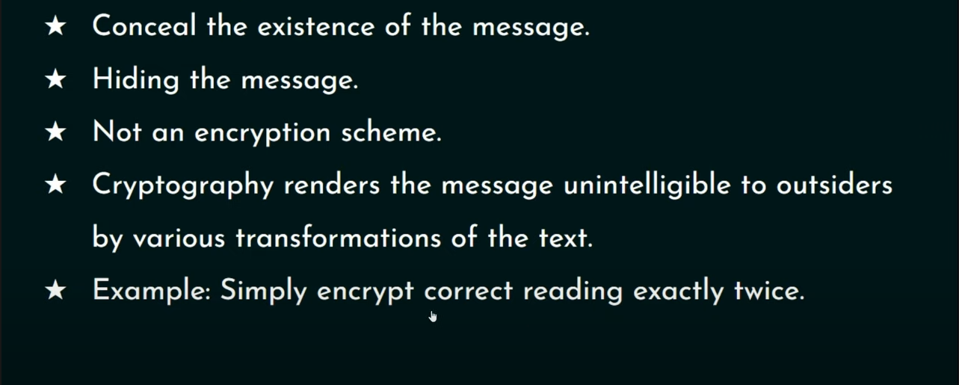
INTRODUCTION

Slide 4
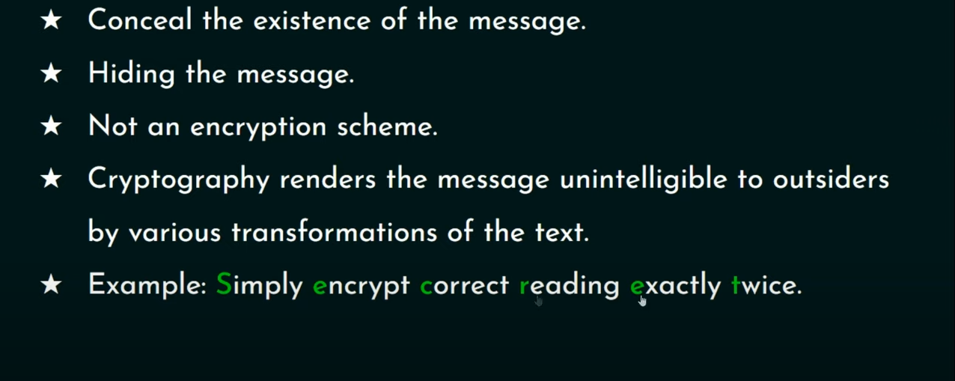
INTRODUCTION

Slide 5
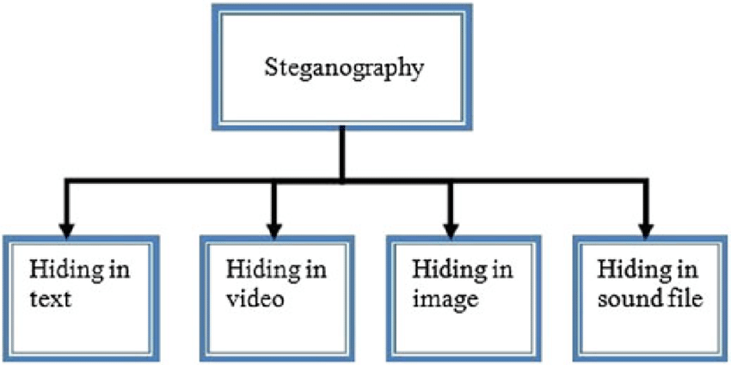
PICTORIAL REPRESENTATION

Slide 6

EXAMPLE
There are many ways to conceal information using Steganography. The most common method is by embedding information into digital images.
We all know that digital images say, a JPEG image, contains several megabytes of data in the form of pixels.

Slide 7
IMAGE STEGANOGRAPHY
Hiding the data by taking the cover object as the image is known as image steganography. In digital steganography, images are widely used cover source because there are a huge number of bits present in the digital representation of an image. There are a lot of ways to hide information inside an image.
Least Significant Bit Insertion
Masking and Filtering
Redundant Pattern Encoding

Slide 8
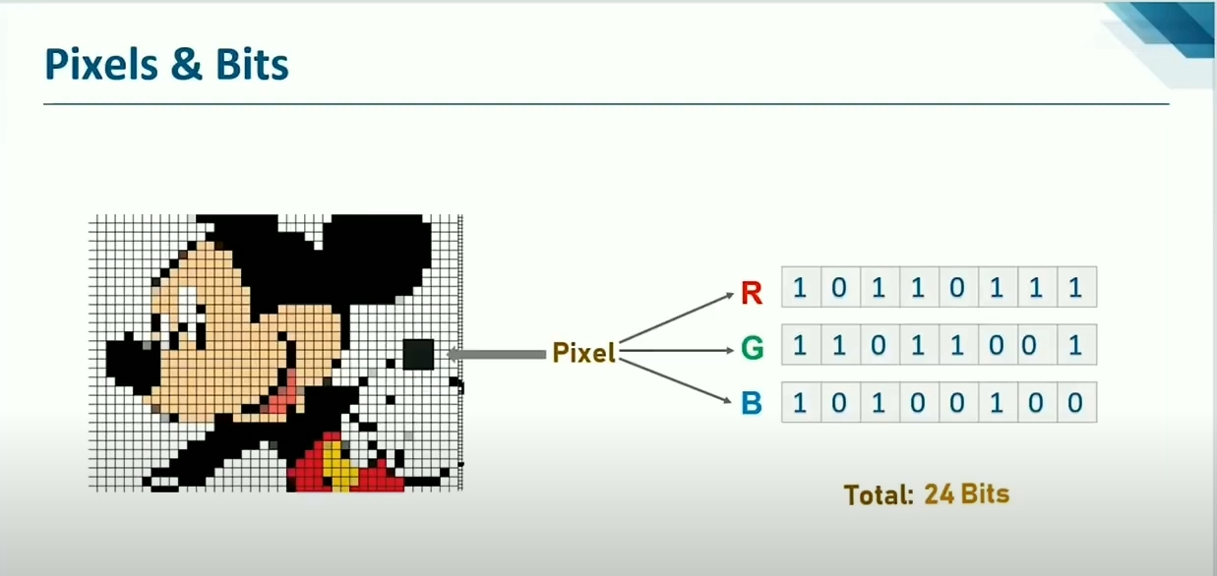

Slide 9
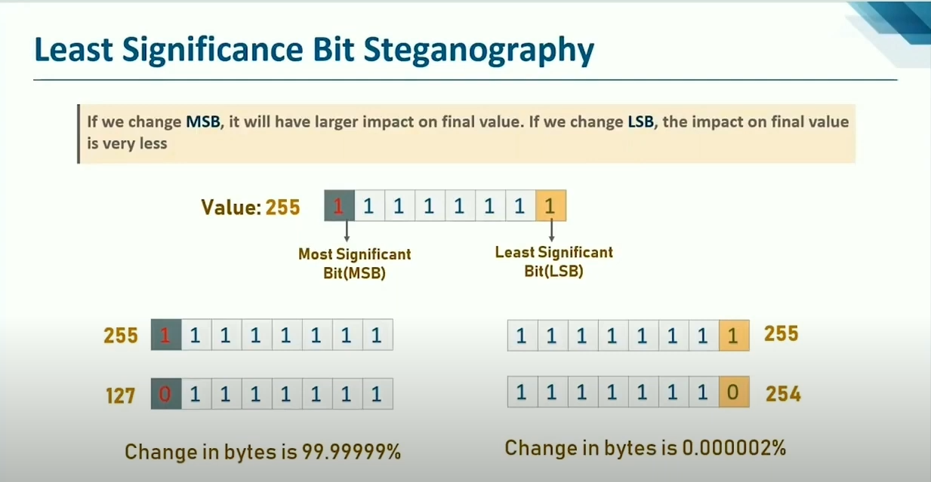

Slide 10
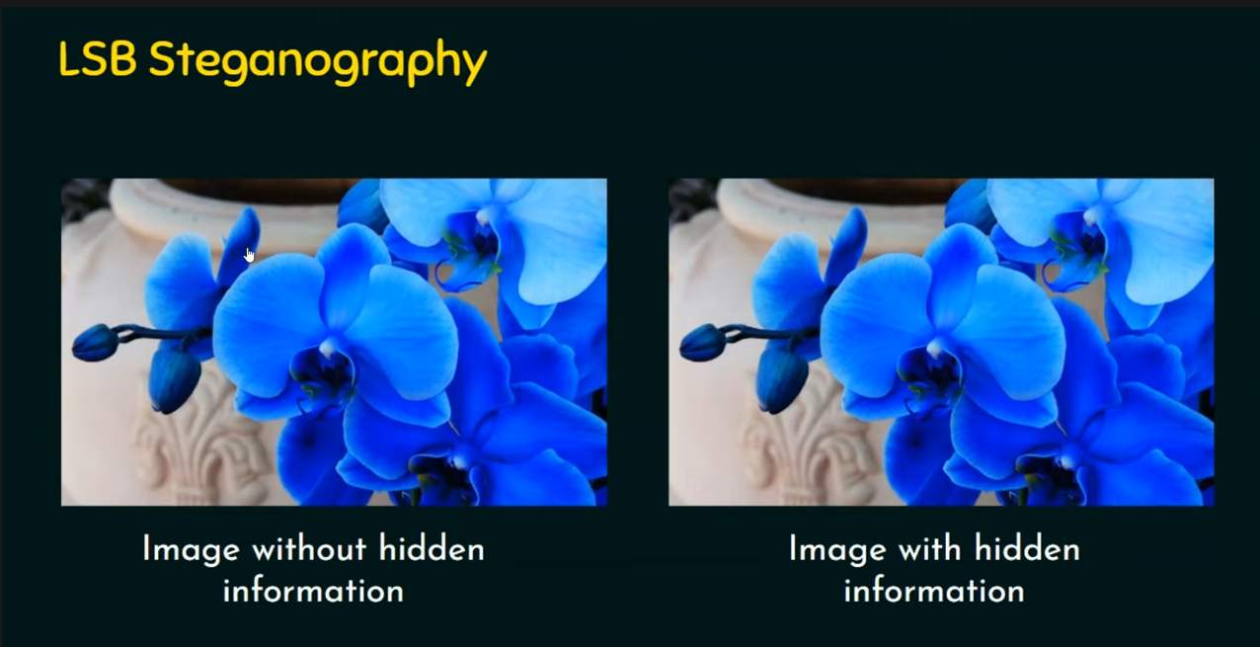

Slide 11
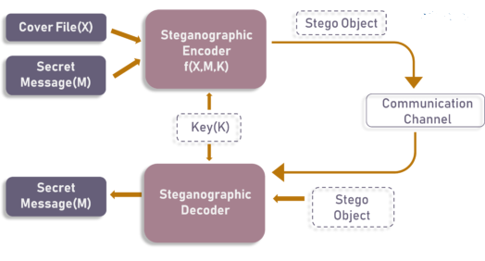
MODEL

Slide 12
ADVANTAGES
Difficult to Detect
Only Receiver can Detect
It can done faster through large no. of softwares
Important communication exchange
Provides better security through LAN, MAN, WAN
Can be applied differently with audio, video and Image.
Hide data over encryption is that it helps obscure the fact that there is sensitive data hidden in the file or other content carrying the hidden text.

Slide 13
DISADVANTAGES
Only Small size of photos can conceal
Breaking down of software or server can replicate the Data
Suspicious Activity Inclusion
Invalidate Signatures
Invalidate Hashing

Slide 14
REFERENCES
https://en.wikipedia.org/wiki/Steganography
https://www.ukessays.com/essays/computer-science/the-types-and-techniques-of-steganography-computer-science-essay.php
https://www.ques10.com/p/33259/explain-steganography-and-its-types/
https://searchsecurity.techtarget.com/definition/steganography#:~:text=Steganography%20is%20the%20technique%20of,for%20hiding%20or%20protecting%20data.
https://www.spiedigitallibrary.org/conference-proceedings-of-spie/6074/60740G/Wireless-steganography/10.1117/12.650263.short?SSO=1

